Slide 1


Lammps Simulation of Thermal Conductivity
Yang Zhou
2015/09/12

Slide 2
Outline
Lec. 1
Molecular Dynamics & Lammps Realization
Method
Lec. 2
Thermal Conductivity Theory & Simulation
Direction
Lec. 3
Trick
Data Analysis with Python
Lec. 4
Use
Thermal Properties of Ar & GNR
Lec. 5
Doping & Rctification & Final Project
Explore
Lec. 6
Personal Presentation
Summarize

Slide 3
Lec. 1
Molecular Dynamics & Lammps Realization
Molecular Dynamics
Simulation Framework
Dynamical Equation
Verlet algorithm
Structure & Boundary
Potential
Velocity Distribution
Neighbor list
Properties
Energy
Temperature
Pressure
RDF
MSD
VACF
Ensembles
NVT
Langivin
Lammps
Linux
basic
ssh
Winscp
Vim & Sublime Text
Tar
Source structure
g++ & Makefile
Execute
Excute in Windows
VMD,ovito,qutemol
Script Framework
Manual
Setup
Material
Device
Measure
Examples
Structure optimization
Melt
histogram
Strain
Rigid body
interactive MD
friction
shear

Slide 4
Molecular Dynamics
Simulation Framework
Dynamical Equation
Verlet algorithm
Structure & Boundary
Potential
Velocity Distribution
Time=0: Structure, potential, boundary condition, velocity distribution
Equilibration: NVT or NPT
Steady State: NVT or NVE, Statistics
Post Procedure: data analysis, plotting

Slide 5
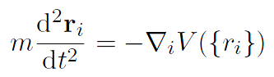
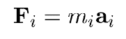
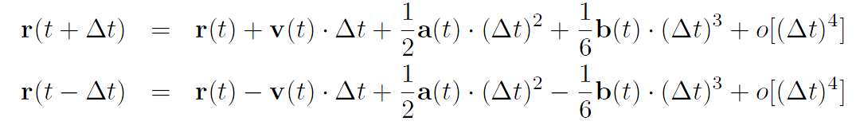
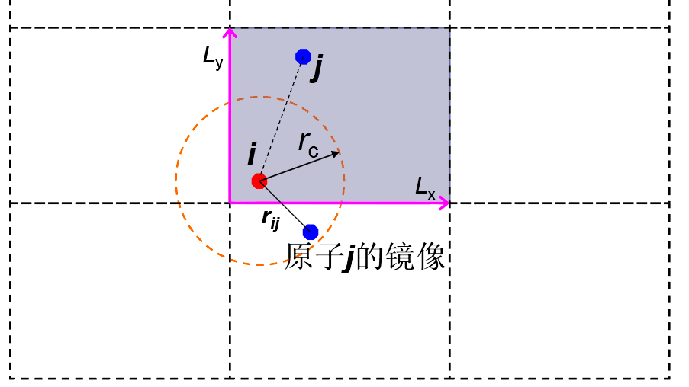

Molecular Dynamics
Simulation Framework
Dynamical Equation
$$⇒$$
Verlet algorithm
Structure & Boundary
Image of j

Slide 6
Molecular Dynamics
Simulation Framework
Neighbor list
In order to reduce the calculation complexity of force from O(N^2) to O(N) , these could be done:
cut off the potential, so we can only calculate the summation over the atoms within the sphere.
save the atoms within the sphere and there’s no need to search the spheres for M steps.
when search for spheres after the M steps, there’s no need to find all the atoms within the sphere, but remove the atoms leaved and add the atoms get close
find neighbor
build neighbor list
update neighbor list

Slide 7
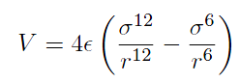
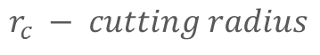
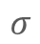
Molecular Dynamics
Simulation Framework
Potential
Lennard-Jones (LJ) Potential
r_{c}
$$σ$$
$$r_{c} − cutting radius$$
Velocity Distribution
Gaussian distribution of Temperature T
Clear out the drift and remaining rotation

Slide 8
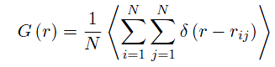
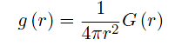
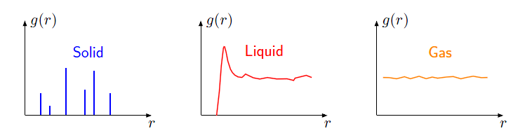
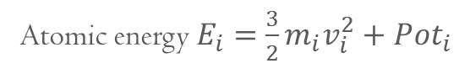
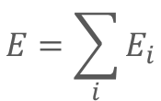
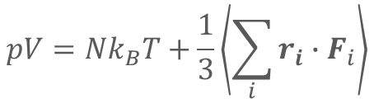
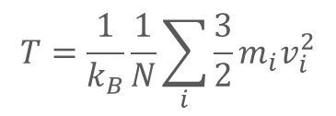
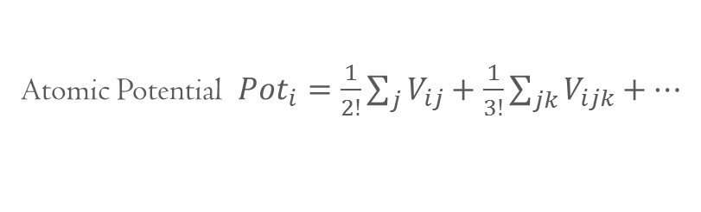
Molecular Dynamics
Properties
Energy
$$E=\sum_{i}{E_{i}}$$
Atomic energy $E_{i}=\frac{3}{2}m_{i}v_{i}^{2}+Pot_{i}$
Atomic Potential $Pot_{i}=\frac{1}{2!}\sum_{j}{V_{ij}}+\frac{1}{3!}\sum_{jk}{V_{ijk}}+⋯$
Temperature
$$T=\frac{1}{k_{B}}\frac{1}{N}\sum_{i}{\frac{3}{2}m_{i}v_{i}^{2}}$$
$$pV=Nk_{B}T+\frac{1}{3}\left\langle \sum_{i}{r_{i}∙F_{i}}\right\rangle$$
Pressure
Virial Thorem
Radial distribution function(RDF)
Pair-Correlation function

Slide 9
Molecular Dynamics
Properties
Mean square displacement(MSD)
MSD
liquid
solid
time
Velocity autocorrelation function(VACF)
VACF
0
t

Slide 10
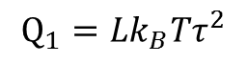
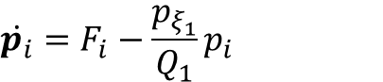
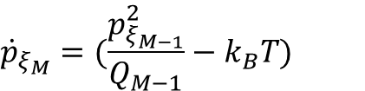
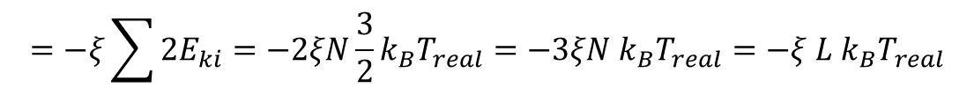
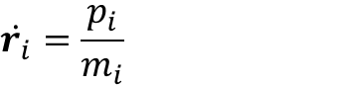
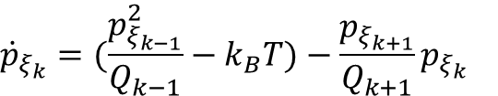
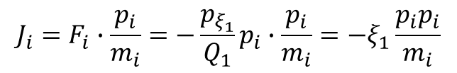
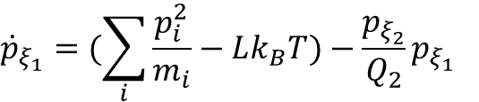
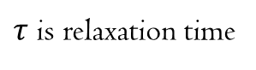
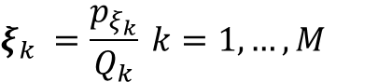
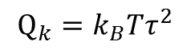
Molecular Dynamics
$$\dot{r_{i}}=\frac{p_{i}}{m_{i}}$$
Ensembles
NVT
$$\dot{p_{i}}=F_{i}−\frac{p_{ξ_{1}}}{Q_{1}}p_{i}$$
Feedback force
$$ξ_{k} =\frac{p_{ξ_{k}}}{Q_{k}} k=1,…,M$$
$${\dot{p}}_{ξ_{1}}=(\sum_{i}{\frac{p_{i}^{2}}{m_{i}}−Lk_{B}T})−\frac{p_{ξ_{2}}}{Q_{2}}p_{ξ_{1}}$$
$${\dot{p}}_{ξ_{k}}=(\frac{p_{ξ_{k−1}}^{2}}{Q_{k−1}}−k_{B}T)−\frac{p_{ξ_{k+1}}}{Q_{k+1}}p_{ξ_{k}}$$
Dynamics of Nose-Hoover Chain
$${\dot{p}}_{ξ_{M}}=(\frac{p_{ξ_{M−1}}^{2}}{Q_{M−1}}−k_{B}T)$$
L=3N is degree of freedom(dof)
$$Q_{1}=Lk_{B}Tτ^{2}$$
$$Q_{k}=k_{B}Tτ^{2}$$
$τ$ is relaxation time
The power of heatbath:
$$J_{i}=F_{i}∙\frac{p_{i}}{m_{i}}=−\frac{p_{ξ_{1}}}{Q_{1}}p_{i}∙\frac{p_{i}}{m_{i}}=−ξ_{1}\frac{{p_{i}p}_{i}}{m_{i}}$$
$$=−ξ\sum{2E_{ki}}=−2ξN\frac{3}{2}k_{B}T_{real}=−3ξN k_{B}T_{real}=−ξ L k_{B}T_{real}$$

Slide 11
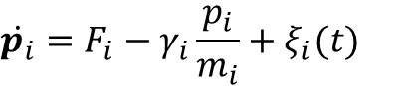
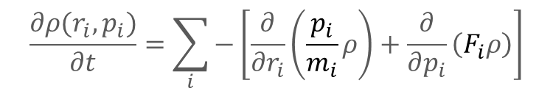
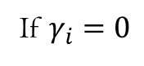
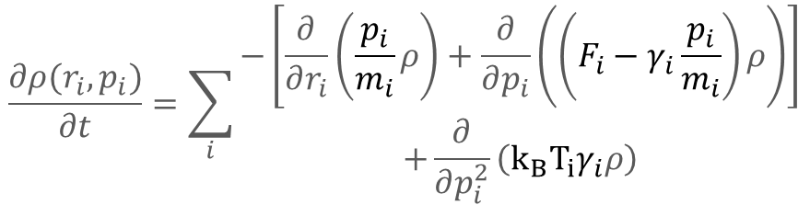
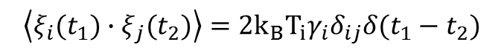
Molecular Dynamics
$$\dot{r_{i}}=\frac{p_{i}}{m_{i}}$$
Ensembles
Langevin
$$\dot{p_{i}}=F_{i}−γ_{i}\frac{p_{i}}{m_{i}}+ξ_{i}(t)$$
$$\left\langle ξ_{i}(t_{1})∙ξ_{j}(t_{2})\right\rangle =2k_{B}T_{i}γ_{i}δ_{ij}δ(t_{1}−t_{2})$$
Plank-Fokker Equation
$$\frac{∂ρ(r_{i},p_{i})}{∂t}=\sum_{i}{\begin{aligned}−\left[\frac{∂}{∂r_{i}}\left(\frac{p_{i}}{m_{i}}ρ\right)+\frac{∂}{∂p_{i}}\left(\left(F_{i}−γ_{i}\frac{p_{i}}{m_{i}}\right)ρ\right)\right] \\ +\frac{∂}{∂p_{i}^{2}}\left(k_{B}T_{i}γ_{i}ρ\right)\end{aligned}}$$
$$\frac{∂ρ(r_{i},p_{i})}{∂t}=\sum_{i}{−\left[\frac{∂}{∂r_{i}}\left(\frac{p_{i}}{m_{i}}ρ\right)+\frac{∂}{∂p_{i}}\left(F_{i}ρ\right)\right]}$$
If $γ_{i}=0$
Liouville Equation

Slide 12


Lammps
Linux
basic
cd -- go into a directory
cd .. -- go into parent directory
cd - -- go into the last directory
tab -- auto complete
ls – view the file list
mkdir – make directory
rm – remove file
rm –r – remove directory
ssh xggong@10.92.2.163
password: gjzzw224
./ZHANGJIANG.sh
ssh
remote console
Winscp
host:10.92.2.163
username : xggong
password : gjzzw224
cd zhangjiang
remote filesystem
Vim & Sublime Text
text editor
Tar
download lammps.tar.gz at http://lammps.sandia.gov/download.html
tar xvf lammps.tar.gz
xtract files

Slide 13
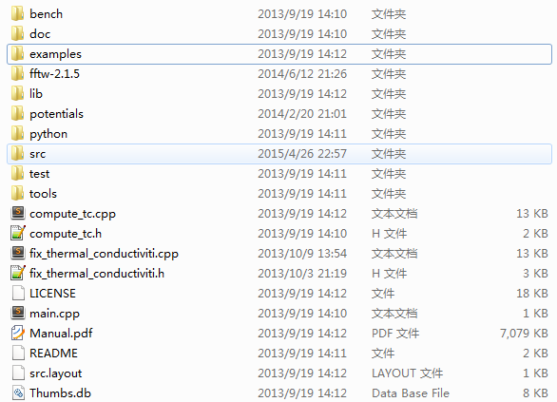
Lammps
manual
Linux
Source structure
scripts
potential files
cpp source
src
packages like “manybody”
make yes-manybody
user-packages like “user-phonon”
copy the code in MANYBODY into current folder
MAKE
cpp & h
compile
cd stubs
make
make serial
you get lmp_serial

Slide 14

Lammps
Linux
g++ & Makefile
g++ -c hello.cpp –o hello.o
g++ -c world.cpp –o world.o
g++ hello.o world.o –o helloworld
compile
link
Makefile : dependency translation
all : hello.o world.o g++ hello.o world.o -o helloworld
hello.o: hello.c
g++ -c hello.c -o hello.o
world.o: world.c g++ -c world.c -o world.o
$$⇔$$
objects = hello.o world.o
all : $(objects) g++ $(objects) -o helloworld
$(objects):%.o : %.c g++ -c $< -o $@
make

Slide 15
Lammps
Linux
Execute
./lmp_serial <in.lmp
mpirun –n 2 lmp_parallel <in.lmp >log.out
pbs
qsub
qstat
qdel
Excute in Windows
download lammps at http://rpm.lammps.org/windows.html
ctrl+r
cmd
lammps.exe<in.lmp

Slide 16
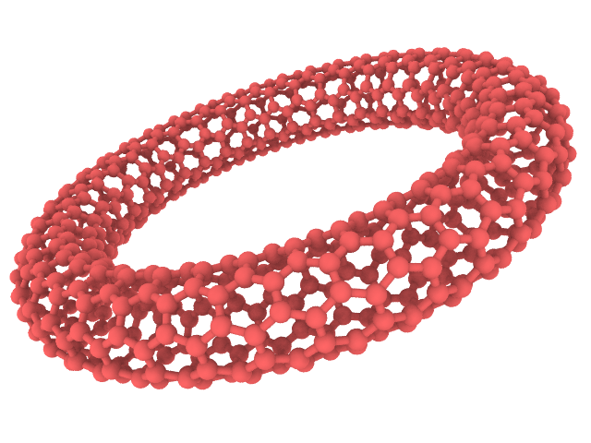
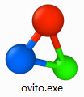

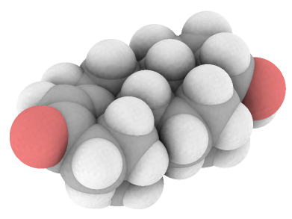
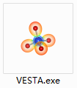
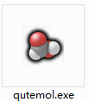
Lammps
Linux
VMD,ovito,qutemol
rendering, coloring
animation
animation, biomolecule render, interactive MD
electronic structure
realistic rendering

Slide 17
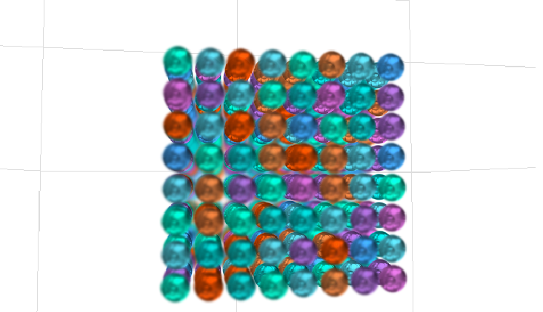
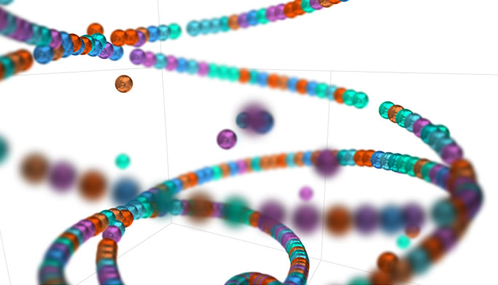
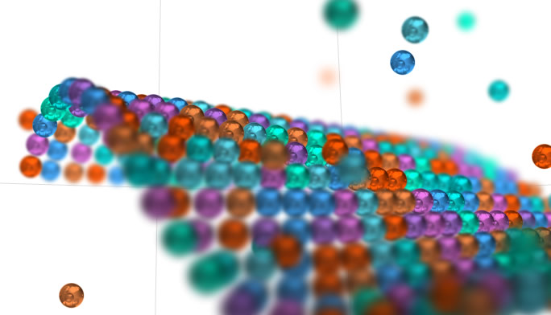
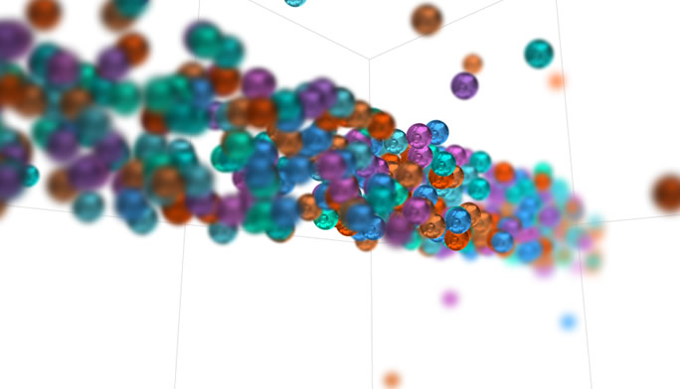
Lammps
Linux
VMD,ovito,qutemol
a cooler renderer

Slide 18
Lammps
Manual
Script Framework
http://lammps.sandia.gov/doc/Manual.html
# 3d Lennard-Jones nvt ensemble
units metal
atom_style atomic
boundary p p p
lattice fcc 5.41229
region box1 block 0 5 0 5 0 5 units lattice
create_box 1 box1
create_atoms 1 box
mass 1 39.948
pair_style lj/cut 8.5125
pair_coeff * * 0.0103235761 3.405 8.5125
neighbor 2.0 bin
neigh_modify every 2 delay 10 check yes
Setup
#unit system : metal ,lj, si …
# others are charge … there is a variable representing charge
#boundary type
#lattice type and constant
#geometrical objects, named as box1
#use box1 to define the space where atoms are in . there’s 1 type of atoms
Material
#create the type 1 atom at all the lattice sites within the box
#mass of atom type 1
#define potential and set cut radius
#for all types of atoms set parameter
#neighbor list type and size
#update rate

Slide 19
Lammps
Script Framework
#1(fs)
timestep 0.001
dump d1 all atom 20 dump.lammpstrj
dump_modify d1 sort id
thermo 20 #output to screen every 20 steps
thermo_style custom step temp pe etotal lx ly lz #which value to be output
velocity all create 40 1234567 mom yes rot yes dist gaussian
fix a1 all nvt temp 40.0 40.0 0.1
region box2 block 0 3 0 5 0 5 units lattice
group g1 region box2
compute T1 g1 temp
fix sqo1 all ave/time 1 5000 10000 c_T1 c_thermo_temp c_thermo_pe file log.Ave
run 10000
# output structure to file , labeled as d1
# sort according to id
#initial velocity to 40K with Gaussian distribution of seed 1234567
,moveout drift and remained rotation
Device
#NVT with start T=40, end T=40, relaxation time=0.1 (ps)
# define group using box2
Measure
# define a compute name as T1,calculating the temperature of g1
# average and output, compute T1 is excuted, so as 2 default computes
#run for 10000 times（10ps）

Slide 20
Lammps
p – periodic
s – free: scale as needed
m – free with lower limit
f – lost if leave out
Supplement
boundary p p p
fix ID group-ID ave/time Nevery Nrepeat Nfreq
Nevery Nrepeat Nfreq=2 3 10
10
20
30
6 8 10
16 18 20
26 28 30
ave
ave
ave
fix a1 all nvt temp 40.0 100.0 Tdamp
Tdamp is usually 0.01*timestep
T
small tdamp
large tdamp
100.0
40.0
tEnd

Slide 21
Lammps
Examples
Structure optimization
always done before any simulation
units lj
atom_style atomic
boundary p p p
dimension 3
lattice fcc 0.844
region box block 0 8 0 8 0 8 units lattice
create_box 2 box
create_atoms 1 box
set group all type/fraction 2 0.04 12393
pair_style lj/cut 2.8
pair_coeff * * 1 1
timestep 0.000466
mass 1 1
mass 2 1.3
thermo_style custom step pe etotal
thermo 10000
fix 1 all box/relax iso 0.0 nreset 1
min_style cg
minimize 1e-12 1e-12 1000000 1000000
dump dump1 all xyz 1 minimize.xyz
dump_modify dump1 element Ar Ap
dump kaka all atom 1 range
run 0
#reduced unit
#must p p p
#change 4% of all the atoms to type 2 with seed 12393
#relax the box to 0.0Pa isotopically every 1 step
#conjugate gradient
#etor ftor eMstep fMstep
#another format of atoms
#naming the two types

Slide 22
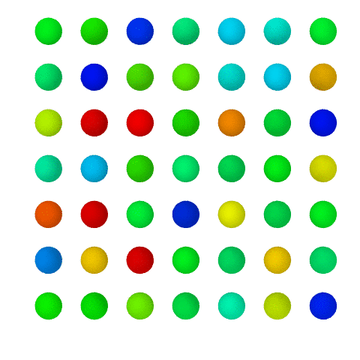
Lammps
Examples
Melt
units lj
atom_style atomic
boundary s s s
lattice fcc 0.8442
region box block 0 3 0 3 0 1
create_box 1 box
create_atoms 1 box
mass 1 1.0
velocity all create .1 87287
pair_style lj/cut 2.5
pair_coeff 1 1 1.0 1.0 2.5
neighbor 0.3 bin
neigh_modify every 20 delay 0 check no
fix 1 all nve
compute ke all ke/atom
dump a all custom 10 dump.melt id type xs ys zs c_ke
dump_modify a sort id
thermo 50
run 1000
#nano-particle
#a small region
coloring according to ke using Ovito (top view)
#verlet algorithm
#kinetic energy of every atom
#besides dump/atom we want c_ke

Slide 23
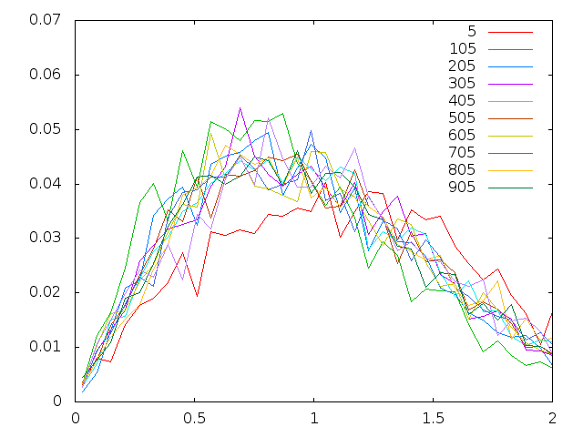
Lammps
#the velocity distribution of sum atoms
Examples
histogram
units lj
atom_style atomic
boundary p p p
region 1 block 0 10 0 10 0 10
create_box 1 1
create_atoms 1 box
mass 1 1
timestep .001
pair_style lj/cut 3
pair_coeff * * 1 1
velocity all create 1 17 rot yes dist gaussian
fix 1 all nve
variable velo atom sqrt(vx*vx+vy*vy+vz*vz)
fix 2 all ave/histo 1 4 5 0 3 50 v_velo mode vector file histo.txt
thermo 100
dump 1 all atom 10 dump.lammpstrj
run 1000
#the scalar velocity
#the velocity distribution of every atom

Slide 24
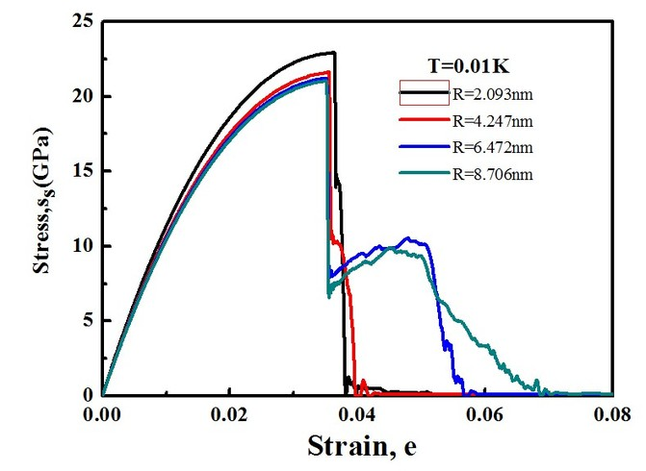
Lammps
Examples
Strain
# tensile testing boundary s s p units metal atom_style full read_data r1.data # potentials pair_style eam pair_coeff * * Fe.eam neighbor 2.0 bin neigh_modify delay 1 check yes # define computes compute myTemp all temp compute disp all displace/atom compute pot all pe/atom compute ke all ke/atom compute s1 all stress/atom compute press all pressure thermo_temp
#tensile along z direction
#read in atoms potitions
#potential for metals
#displacement of every atom
#stress tensor

Slide 25
Lammps
Examples
Strain
thermo_style custom step temp etotal ke pe lz ly lx press pxx pyy pzz dump 1 all custom 5000 dump.tensile id type x y z c_pot c_ke c_disp[3] c_s1[1] c_s1[2] c_s1[3] c_s1[4] c_s1[5] c_s1[6] minimize 1.0e-5 0 1000 100000 velocity all create 100 887723 temp myTemp rot yes dist gaussian units box fix 1 all npt 100 100 1.0 iso 0.0 0.0 10.0 drag 1.0 thermo 1000 timestep 0.0005 run 200000 unfix 1 fix 1 all nve fix 2 all temp/berendsen 100 100 1.0 fix 3 all deform 1 z erate 0.0002 remap x units box run 1000000
#output some global values
#output atomic values
#no lattice defined so use box units
#equilibrium using NPT. T=100,tDump=1.0,
P=0,pDump=10.0, drag is used to accelerate convergence
#remove npt
#another heat bath without integration
#deform along z and remap positions every 10000/2*timestep steps

Slide 26
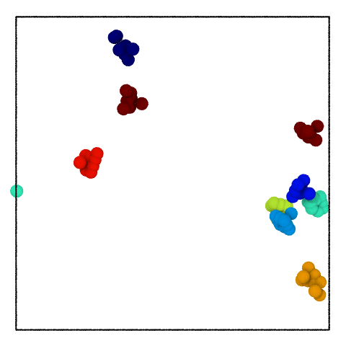
Lammps
Examples
Rigid body
# Simple rigid body system
units lj
atom_style atomic
pair_style lj/cut 2.5
read_data data.rigid
velocity all create 100.0 4928459
# unconnected bodies
group clump1 id <> 1 9
group clump2 id <> 10 18
group clump3 id <> 19 27
group clump4 id <> 28 36
group clump5 id <> 37 45
group clump6 id <> 46 54
group clump7 id <> 55 63
group clump8 id <> 64 72
group clump9 id <> 73 81
fix 1 all rigid group 9 clump1 clump2 clump3 clump4 clump5 clump6 clump7 clump8 clump9
#define groups according to ids ranges
#define 9 rigid bodies

Slide 27
Lammps
Examples
Rigid body
neigh_modify exclude group clump1 clump1
neigh_modify exclude group clump2 clump2
neigh_modify exclude group clump3 clump3
neigh_modify exclude group clump4 clump4
neigh_modify exclude group clump5 clump5
neigh_modify exclude group clump6 clump6
neigh_modify exclude group clump7 clump7
neigh_modify exclude group clump8 clump8
neigh_modify exclude group clump9 clump9
thermo 100
dump 1 all atom 50 dump.rigid
timestep 0.0001
thermo 50
run 10000
#cancel neighbor list for efficiency

Slide 28
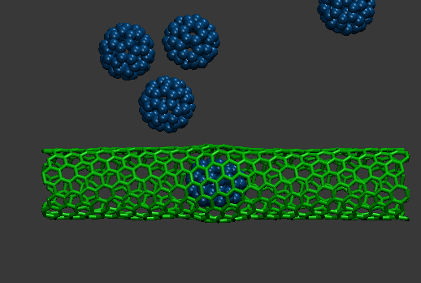
Lammps
Examples
interactive MD
lmp_serial.exe <in.bucky-plus-cnt
vmd –e bucky_cnt_imd.vmd
read_data data.bucky-plus-cnt
fix comm all imd 6789 unwrap on trate 10
in bucky_cnt_imd.vmd:
imd connect localhost 6789

Slide 29
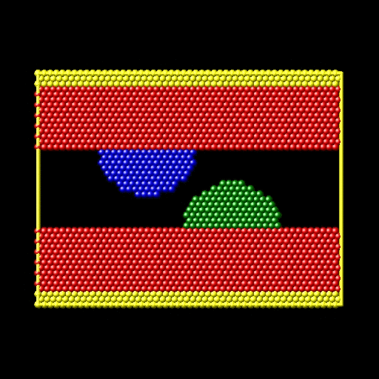
Lammps
friction
Examples
# 2d friction simulation
dimension 2
boundary p s p
atom_style atomic
neighbor 0.3 bin
neigh_modify delay 5
# create geometry
lattice hex 0.9
region box block 0 50 0 22 -0.25 0.25
create_box 4 box
mass 1 1.0
mass 2 1.0
mass 3 1.0
mass 4 1.0
# atom regions
region lo-fixed block INF INF INF 1.1 INF INF
region lo-slab block INF INF INF 7 INF INF
region above-lo block INF INF INF 7 INF INF side out
region hi-fixed block INF INF 20.9 INF INF INF
region hi-slab block INF INF 15 INF INF INF
region below-hi block INF INF 15 INF INF INF side out
region lo-asperity sphere 32 7 0 8
region hi-asperity sphere 18 15 0 8
region lo-half-sphere intersect 2 lo-asperity above-lo
region hi-half-sphere intersect 2 hi-asperity below-hi
# four types of atoms

Slide 30
Lammps
friction
Examples
# create 2 surfaces with asperities
create_atoms 1 region lo-slab
create_atoms 1 region hi-slab
create_atoms 2 region lo-half-sphere
create_atoms 3 region hi-half-sphere
# LJ potentials
pair_style lj/cut 2.5
pair_coeff * * 1.0 1.0 2.5
# define groups
group lo region lo-slab
group lo type 2
group hi region hi-slab
group hi type 3
group lo-fixed region lo-fixed
group hi-fixed region hi-fixed
group boundary union lo-fixed hi-fixed
group mobile subtract all boundary
set group lo-fixed type 4
set group hi-fixed type 4
# initial velocities
compute new mobile temp/partial 0 1 0
velocity mobile create 0.1 482748 temp new
velocity hi set 1.0 0.0 0.0 sum yes
# calculate y part temperature
# additional velocity along x

Slide 31
Lammps
friction
Examples
# fixes
fix 1 all nve
fix 2 boundary setforce 0.0 0.0 0.0
fix 3 mobile temp/rescale 200 0.1 0.1 0.02 1.0
fix_modify 3 temp new
# Run
timestep 0.0025
thermo 1000
thermo_modify temp new
dump 1 all atom 500 dump.friction
run 20000
# remove force

Slide 32
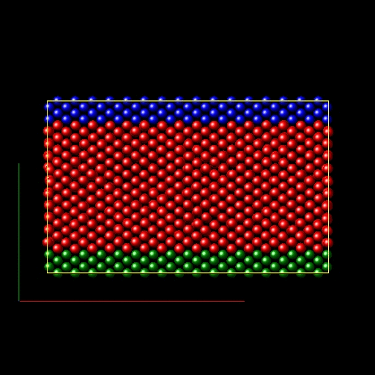
Lammps
shear
Examples
# 3d metal shear simulation
units metal
boundary s s p
atom_style atomic
lattice fcc 3.52
region box block 0 16.0 0 10.0 0 2.828427
create_box 3 box
lattice fcc 3.52 orient x 1 0 0 orient y 0 1 1 orient z 0 -1 1 origin 0.5 0 0
create_atoms 1 box
pair_style eam
pair_coeff * * Ni_u3.eam
neighbor 0.3 bin
neigh_modify delay 5
region lower block INF INF INF 0.9 INF INF
region upper block INF INF 6.1 INF INF INF
group lower region lower
group upper region upper
group boundary union lower upper
group mobile subtract all boundary
set group lower type 2
set group upper type 3

Slide 33
Lammps
shear
Examples
compute new3d mobile temp
compute new2d mobile temp/partial 0 1 1
# equilibrate
velocity mobile create 300.0 5812775 temp new3d
fix 1 all nve
fix 2 boundary setforce 0.0 0.0 0.0
fix 3 mobile temp/rescale 10 300.0 300.0 10.0 1.0
fix_modify 3 temp new3d
thermo 25
thermo_modify temp new3d
timestep 0.001
run 100
# remove force

Slide 34
Lammps
shear
Examples
# shear
velocity upper set 1.0 0 0
velocity mobile ramp vx 0.0 1.0 y 1.4 8.6 sum yes
unfix 3
fix 3 mobile temp/rescale 10 300.0 300.0 10.0 1.0
fix_modify 3 temp new2d
thermo 100
thermo_modify temp new2d
reset_timestep 0
run 3000
# a linear distribution of vx

Slide 35
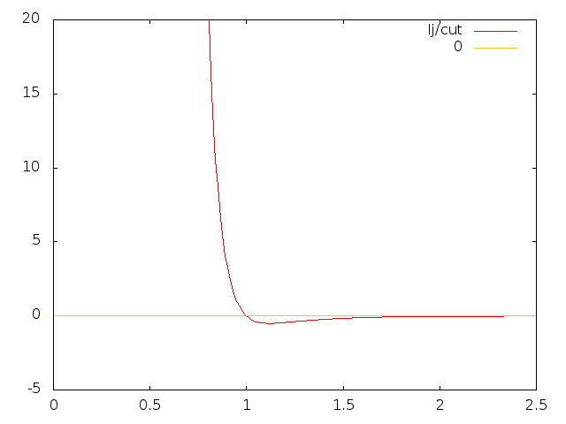
Summery
Molecular Dynamics & Lammps Realization
Basic conception of molecular dynamics
Basic Linux commands
Lammps installation and using
Visualization ,some examples
Homework
make your folder and compile lammps in it
read the manual , be familiar with the commands , especially the fixes and computes in the examples.
draw the potential curve of 2 Ar atoms(in metal unit)
carry out a NVT simulation at 40K of Ar 8x8x8 supercell, plot T vs. t, E vs. t, average T vs. t, average E vs. t. Error vs.t .
Validate Maxwell velocity distribution. curves of 5 different temperature are required in a single graph. Fit them .
plot variance of T and E/N vs. N and fit this curve. N is number of the atoms.
hand in a report before Thursday.

